Slide 1
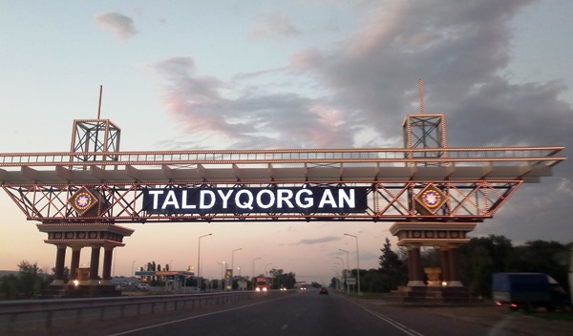
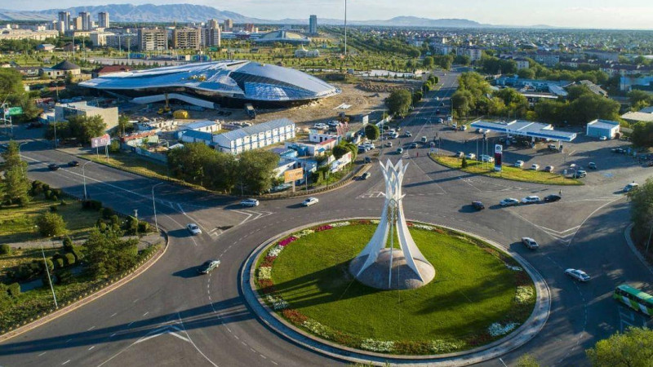
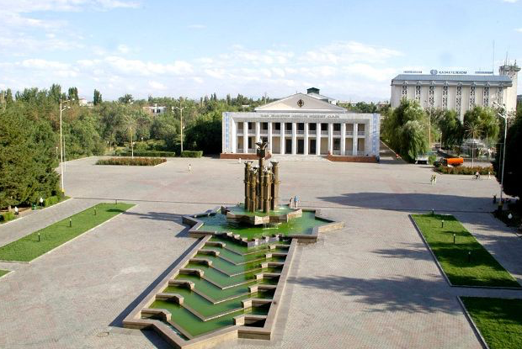
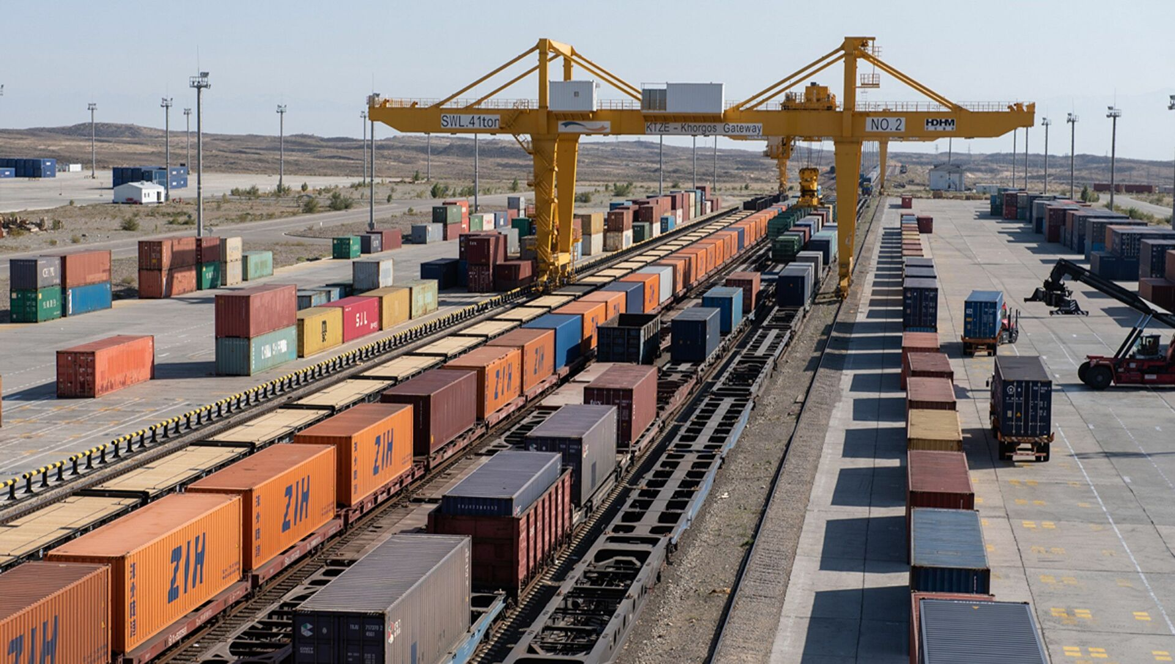
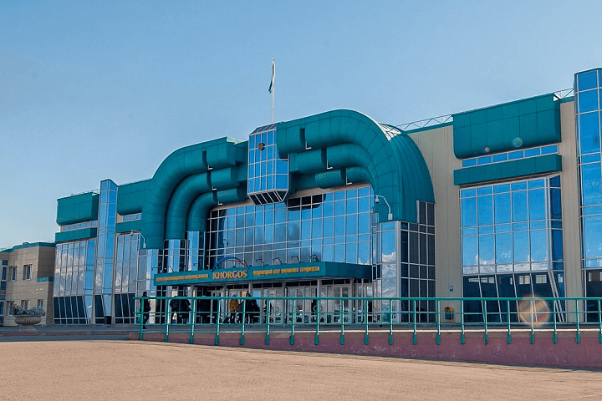
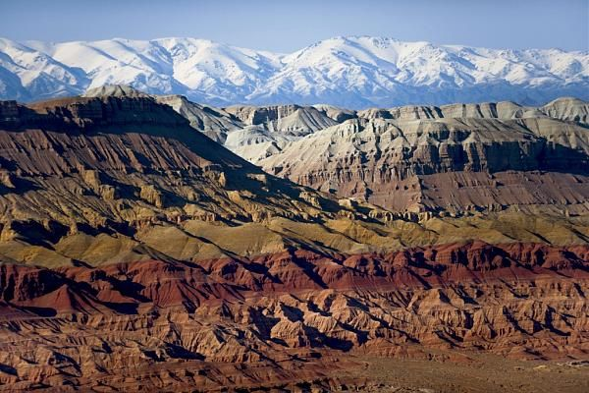
INVESTMENT OPPORTUNITIES
OF JETYSU REGION

Slide 2
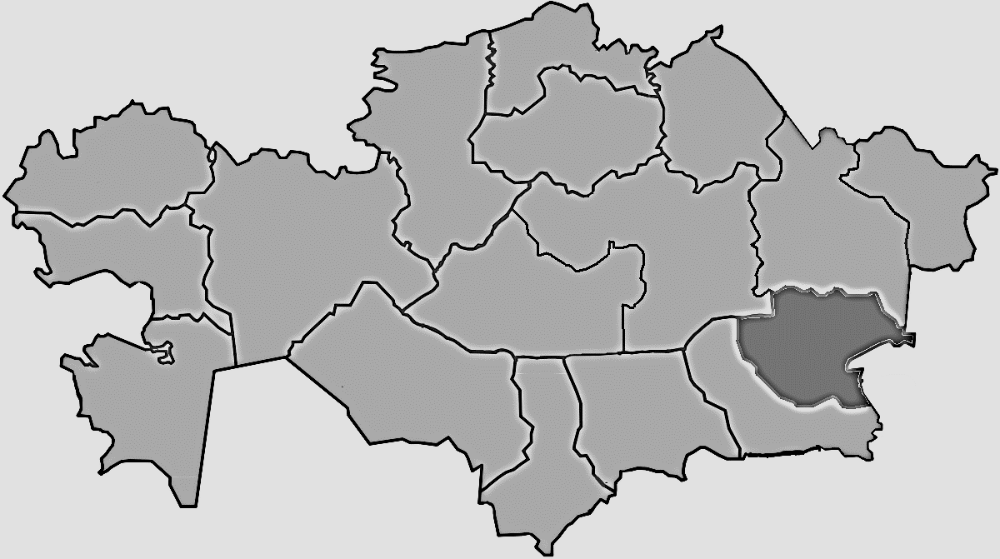
JETYSU REGION
GENERAL INFORMATON
Area
118,5 thousand km²
Population
650 000 (est.) people
Territorial division
The region consists of 8 districts and 2 cities of regional subordination
Regional center
^{Taldykorgan city}
Jetysu region
TOP-4 PRIORITY SECTORS:
Agriculture
Renewable power sources
Tourism
Processing industry

Slide 4
INVESTMENT PORTFOLIO OF JETYSU REGION
INVESTMENT PORTFOLIO OF JETYSU REGION 2022-2030
270
₸1 704
14 000
projects
bln.
working places
ONGOING PROJECTS
177
₸1 299
9 000
projects
bln.
working places
WITH FOREIGN PARTICIPATION
8
₸770,2
3 700
projects
bln.
working places
PROJECTS SCHEDULED FOR COMMISSIONING IN 2022
53
₸ 49
1 200
projects
bln.
working places

Slide 5
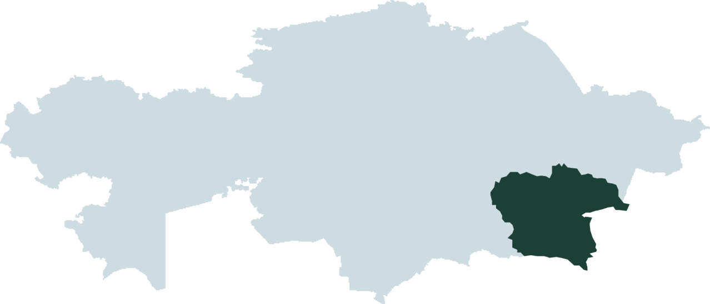
TRANSIT POTENTIAL
The possibility of entering the EAEU market with a population of over 183 million people
Lianyungang
Khorgos
Brest
10 days
9 654 km
Lianyungang
Khorgos
Hamburg
13-14 days
11 516 km
Lianyungang
Khorgos
Istanbul
15-18 days
10 989 km

Slide 6
«KHORGOS – EASTERN GATES» SEZ
4 591 ha
ELECTRICITY SUPPLY
Area
40 mW/h
129,8 га
WATER SUPPLY
2 900 m3/sec
«Dry port» TLC
RAILWAYS
224,4 га
24 km
Industrial zone
224,9 га
Logistic zone
4 012,4 га
Reserved area
INCENTIVES
100%
CIT exemption
0%
Land tax
0%
Property tax
NO RENT
on land plots for the medium-term period
FREE CUSTOMS ZONE

Slide 7
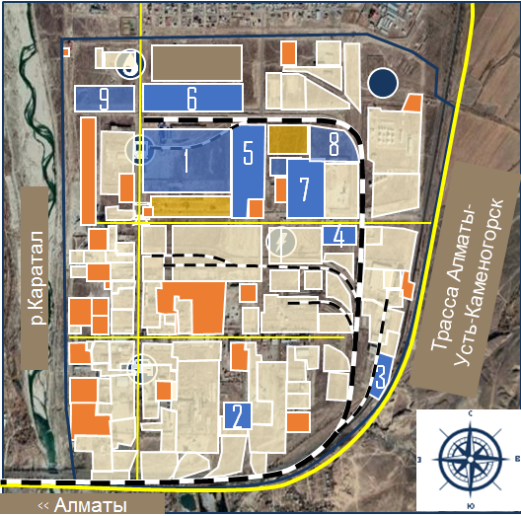
«TALDYKORGAN» INDUSTRIAL ZONE
595 ha
Total area
35 ha
Free area
Current projects
Ongoing projects
Amount of ongoing projects
Created working places
6
2
12
bln.tenge
300
AVAILABLE CAPACITIES
ELECTRICITY
NETWORKS
TILL AIRPORT
2 х 40 000 kV
19,4 km
15 km
WATER SUPPLY
RAILWAYS
TILL ALMATY
18 000 m³/day
15 wagons/day
240 km
WATER DISPOSAL
ROADS
14 000 m³/day
9,7 km
GAS SUPPLY
STREET LIGHTING
5 000 m³/h
4,3 km

Slide 8
LIST OF JETYSU REGION PROJECTS, REQUIRING ADDITIONAL FINANCING

Slide 9
«Tekesu Outdoor Center» LLP - construction of a year-round tourist ski center Tekeli city
Cost
Capacity
25 bln.tenge
30% own,
70%-the need for investor funds
15 000 visitors per year
Land plot
Working places
100 people
12 000 ha

Slide 10
“Virshki Igor Alikovich“ SE- construction and maintenance of a cable car, a sports and tourist recreation center
Eskeldy district
Cost
Capacity
600 mln.tenge
100%-the need for investor funds
6 000 visitors per season
Land plot
Working places
50 people
14 100 ha

Slide 11
“Phoenix company“ LLP- construction of a health and sports center on the Alakol Lake shore
Cost
Capacity
4,2 bln.tenge
100% -the need for investor funds
800 cottages (120 sq.m.) and 600 studio apartments
Working places
Land plot
60 people
20 ha

Slide 12
«Shokai Best» LLP- construction of a sanatorium-tourist-wellness center on the Alakol lake shore
Cost
Capacity
6,3 bln.tenge
100% -the need for investor funds
90 000 tourists per year,
400 places
Working places
Land plot
120 people
4 ha

Slide 13
«Zharkent fruits» LLP - construction of a fruit storage facility and a plant for processing fruit and berry crops Panfilov district
Cost
Capacity
9 bln.tenge
100% -the need for investor funds
Elevator for 8,000 tons of one-time storage of soybeans. Plant from 3 tons/hour (soybean cake and oil)
Land plot
Working places
Рабочие места
50 people
50 человек
1 100 ha existing garden

Slide 14
«NUR-BIRLIK» SEC - development of animal husbandry using Amaranth forage culture
Panfilov district
Cost
Capacity
8,1 bln.tenge
100% -the need for investor funds
60 thousand tones per year
Working places
Land plot
150 people
296 ha

Slide 15
“Boztogan Agro“ LLP- dairy farm construction
Koksu district
Cost
Capacity
1,2 bln.tenge
100% -the need for investor funds
2,2 mln. liters per year
Land plot
Working places
30 people
350 ha

Slide 16
«AGROPARK QAZYNA» LLP - creation of a technological agropark for the production of livestock and crop production
Aksu district
Cost
Capacity
945,7 mln.tenge
15%-own funds,
85% -the need for investor funds
15 thousand heads per year development of 680 hectares of irrigated land
Land plot
Working places
74 people
830 ha

Slide 17
“Kausar Agro“ LLP- creation of a poultry complex for the cultivation of broilers
Kerbulak district
Cost
Capacity
41 bln.tenge
14,000 tons of broiler meat, 3,000 tons of offal per year
Working places
Land plot
750 people
400 ha

Slide 18
"Agricole“ LLP - cultivation, harvesting and processing of oilseed crops
Alakol district
Cost
Capacity
7 bln.tenge
73 000 tones per year
Working places
Land plot
120 people
to be defined

Slide 19
“Bekzat“ LLP- construction of a hydro power station on the Koksu river
Koksu district
Cost
Capacity
4,2 bln.tenge
7 MW
Land plot
Working places
15 people
32 ha

Slide 20
SOCIAL FACILITIES OF JETYSU REGION
ИНДУСТРИАЛЬНАЯ ЗОНА «ТАЛДЫКОРГАН»
1
CONSTRUCTION OF A HEALTH CAMP FOR CHILDREN from socially vulnerable segments of the population for 120 places in Taldykorgan city. Investments: 2.8 billion tenge (DED available)
IT SCHOOL CONSTRUCTION FOR 150 STUDENTS with a hostel for 100 students and sports grounds in the eastern part of Taldykorgan city. Investments: 4.3 billion tenge
OVERHAUL OF A SUBURBAN CHILDREN'S CAMP in Taldybulak village, Kerbulak district. Investments: 382.9 million tenge.
CONSTRUCTION OF A NEW BLOCK with seismic amplification of the existing blocks of the State Utility Enterprise on the "Regional Oncological Dispensary" REM in Taldykorgan. Investments: 4 billion tenge (DED is under development).
CONSTRUCTION OF A MEDICAL CENTER for 10 visits per shift in the village. Kengaryp Aksu district, cost 114.3 million tenge.
FIRST-AID STATION CONSTRUCTION for 15 visits per shift in Kamyskala village , Alakol district, cost 153.6 million tenge.
CONSTRUCTION OF A SPORTS COMPLEX FOR A CLIMBING WALL AND RHYTHMIC GYMNASTICS in accordance with international standards in the city of Taldykorgan, cost of the project is 1 billion tenge.
CONSTRUCTION OF A MODULAR FOOTBALL ARENA (DED is not required), the cost of the project is 4 billion tenge
2
3
4
5
6
7
8

