Slide 1

The SMART-HUBs Project - CoA Profile
Rompolas Georgios, Project Manager CoA
SMART-HUBs
“Enhancing employment access developing NEET' skills and capabilities to sustain the economic-SMART transition of socio-cultural-tourist destinations by CCIs HUBs contaminations”

Slide 2

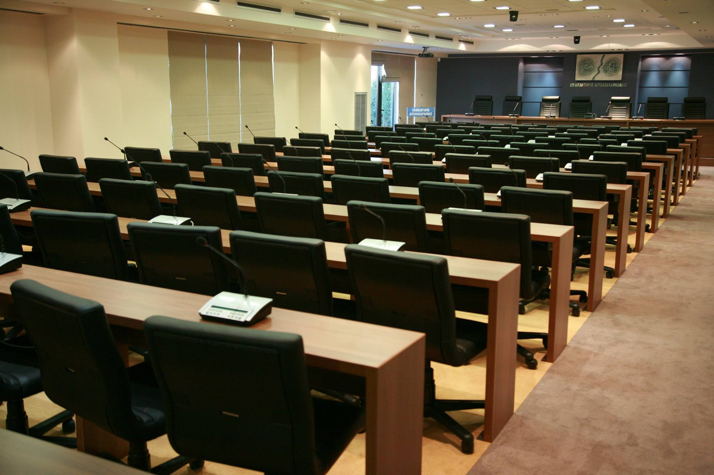
About Us
The Aetoloakarnania Chamber serves as a pivotal organization for economic development in the Region of Western Greece.
It supports local businesses and entrepreneurs by providing guidance, resources, and networking opportunities
The Chamber plays a crucial role in promoting regional economic interests and facilitating collaboration among public and private entities to enhance the local economic landscape

Slide 3
CoA Strategies & Projects
For the achievement of the previous purposes’ the Chamber of Aetolokarnania elaborates strategies which are supported through the submission and the implementation of projects in National, Regional and International level. CoA has significant experience to the implementation of EU co-financed projects or other international projects. With 33 projects implemented in the last 25 years.
In recent years, we matured and elaborated many strategies and indicative actions for the reinforcement of the common vision for the creation and the development of cultural industry in connection also with cultural tourism. The CoA during the previus programming period cooperates with the Region of Western Greece and the Regional Development Fund as also with other transnational bodies and implements the following projects and strategies,
the "Aetolian Hospitality " project, a tourism-cultural digital tool,
We have the management, of the 2 creative hubs, to support the entrepreneurship of the creative industries (CREATIVE@ HUBs Project in collaboration with the Region of Western Greece and the Regional Development Fund),
the LOCAL CONTACT POINT of ECAPITAL CULTURE Adriatic Start up School in Aetoloakarnania territory (In collaboration with the FORUM AIC),
and the LOCAL CONTACT POINT of the Enterprise Europe Network-Hellas (EEN-Hellas 2025) in Aetoloakarnania province.

Slide 4
CoA Strategies & Projects
In the 2021-2027 programming period we participate in the implementation of the,
SMART-HUBs project / Partnership (CCI Hubs),
"Aetolian Hospitality II",
Integrated Event Management Platform for Smart Organization and Effective Communication,
All the above projects and tools proves, the CoA strategically dedication to implement a reinforce mechanism of synergy between creative businesses and policy makers to enhance regions' capacity for producing new knowledge and innovation, contacted also with digitalization, related to the development of the cultural industry and cultural tourism in the Adriatic and Ionian Macro-Region.

Slide 5
The SMART-HUBs project
SMART-HUBs project: General Information
Cross-Border Cooperation Programme : INTERREG VI-A “Greece -Italy 2021-2027”
Priority Axis 3:Enhanced cooperation for a more social and inclusive GR-IT area
Intervention field: Specific support for youth employment and socio-economic integration of young people
Specific Objective RSO4.2: Education and training infrastructure
Duration: 24 months (5/2025 –5/2027)
Budget: 1.485.410,16 €
Partnership (CCI Hubs)
1. (LP) REGIONAL DEVELOPMENT FUND/REGION OF WESTERN GREECE (GR)
2. CHAMBER OR AETOLOAKARNANIA (GR)
3. ZAKYNTHOS CHAMBER OF COMMERCE (GR)
4. MUNICIPALITY OF NARDO (IT)
5. MATERAHUB CULTURAL AND CREATIVE INDUSTRIES CONSORTIUM SCARL (IT)
6. MUNICIPALITY OF MAIDA (IT)

Slide 6
Project Background
The cross-border GR IT areas face significant social challenges such as a high number of NEETs (Not in Education, Employment, or Training), unequal access to education/employment and high unemployment level, which highlight the need for improved social policies to bridge the gap between education and labor market.
Furthermore, the digital divide hampers the knowledge spread and the labor access and, the weak business-green-digital skills hinder the digital resilient transformation of related societies.
Against this, project areas present a rich cultural-creative heritage, whose full potential as generator of sustainable tourism remains underused as shown by the unprecedented Covid-19 pandemic that was a hard hit for this sector mainly for its weak green-digital maturity.

Slide 7
Main Goals
SMART-HUBs aims to address regional disparities, empower youth, making opportunities more accessible to a wider audience by developing new entrepreneurial-green-digital skills in cultural-tourism.
The project supports the digital and social transition of the participating regions by promoting the dissemination of digital technologies in cultural assets –tangible cultural heritage (libraries, museums and buildings), local traditions, creative theatrical and entertainment performances.

Slide 8
Project Objectives
Empower NEETs (youth not in education, employment, or training)
Provide green, digital, and entrepreneurial skills for cultural and tourism sectors
Foster sustainable cultural heritage management
Build common Capacity Building, Educational & Training Programmes and Platforms
Support cross-border cooperation between Greece and Italy

Slide 9
Planned Actions
Studies / analysis of professional and training needs in the partner regions
Co-design Labs, Workshops, training programs
Development of a cross-border digital e-learning platform
Creation/equipment of 6 physical hubs in Greece and Italy
Digitalization of cultural assets and AR/VR applications
Capacity Building Program with stakeholders
Creative cultural events (theatre, book-trailers, performances)

Slide 10
Project Workplan

Slide 11
Project outputs
Across-border analysis of common educational and professional needs, presented through a storytelling video.
Six innovative facilities that will allow for the improvement of the management, conservation and enjoyment of identified cultural assets through training & capacity building programmes.
A joint innovative e-learning platform for the cultural-tourism sector, which will provide cultural educational services to enhance the unique potential of the cultural identities of the regions.
An integrated Skills Empowerment Programme with the participation of public and private actors and six creative cultural events that will attract visitors through the combined virtual and physical experience.
Two Training Programmes to be implemented by CCIs knowledge HUBs for the development of improved digital services in tourist destinations, for the benefit of NEETs.

Slide 12
Expected results
Improved employability and skills of NEETs
Stronger digital and green competences in the sectors of tourism and cultural and creative industries
Revitalized cultural heritage with digital tools
Increased cross-border cooperation
Enhanced socio-economic integration in Greece and Italy

Slide 13
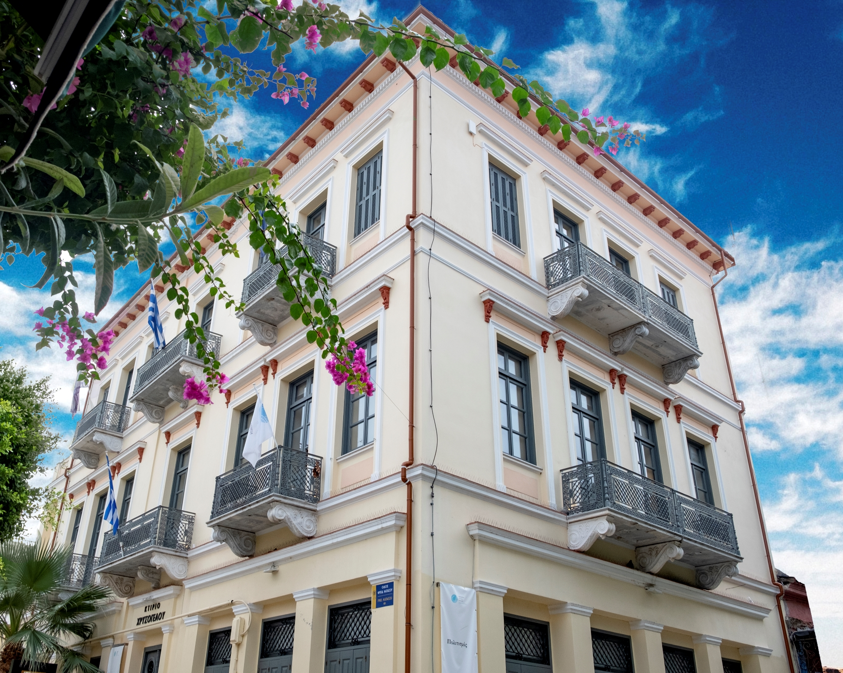
The SMART-HUBs project
importance for the Territory of RWG
CCI in the focus of the regional policies
Complementarities with other projects in CCI (DigiContent, CHERRY, SPARC, "Aetolian Hospitality I & II, etc.)
Capitalization of the results of the strategic project “CREATIVE@HUBs”
Further exploitation of the HUBs of Patras, Messolonghi and Agrinio with specialized equipment for building green and digital skills

Slide 14
The SMART-HUBs project importance for the Territory of RWG
- Work to reduce digital gaps and fragmentation in the CCIs, enabling regions and organisations to adopt modern digital solutions.
- Promote the use of immersive and advanced technologies (ΧR-> AR/MR/VR) for cultural heritage, digital content creation, capacity building and enhanced audience engagement in CCIs.
- Invest in skills development and workforce empowerment, helping NEETs, professionals and organizations build the capabilities required for a competitive and digitally mature creative sector.
- Strengthen regional CCI ecosystems and infrastructures, from creative hubs and training platforms to shared learning frameworks and cross-border cooperation.
- Supporting inclusive and sustainable growth in CCIs and tourism, creating new opportunities for NEETs.

Slide 15

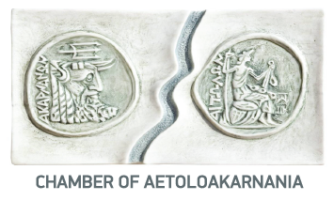
Thanks a lot for your attention !

